Slide 1

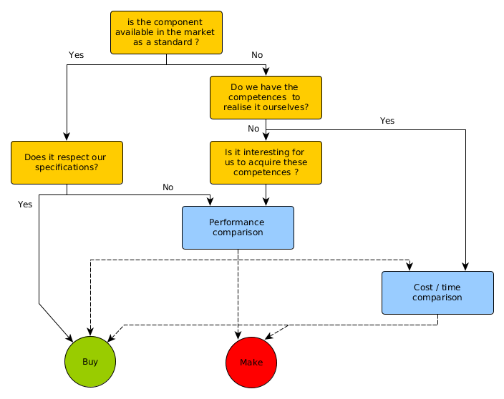
Make or buy decisions
Arbitrage between make and buy
Lorem Le format d’impression A2

